Slide 1
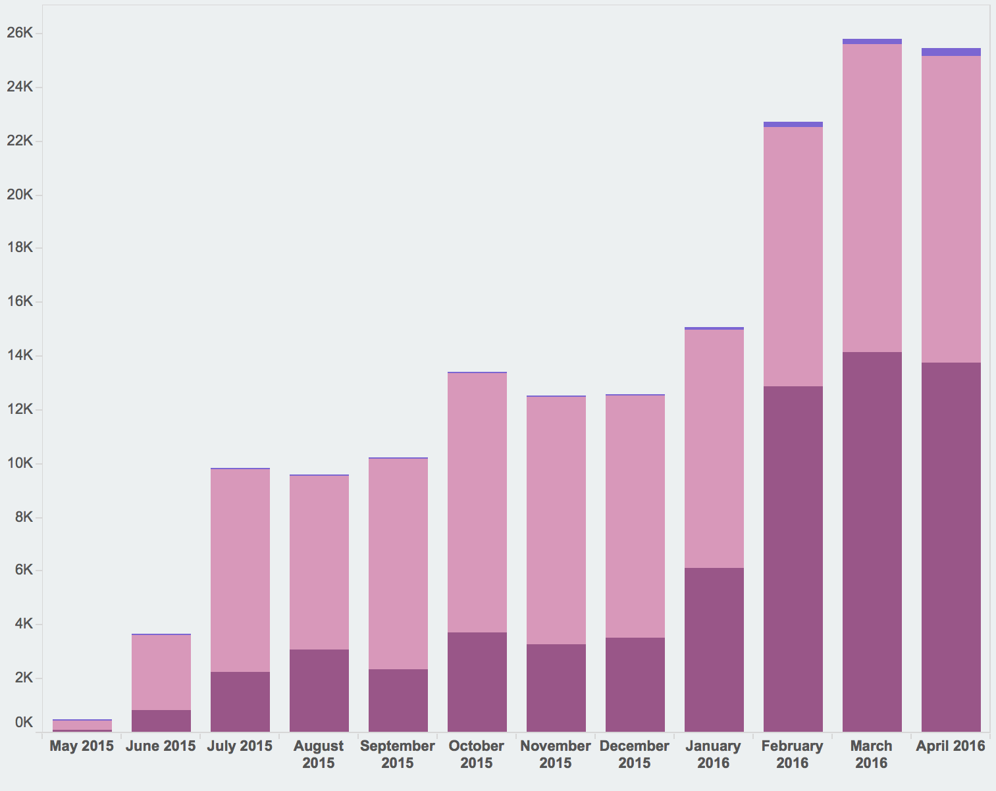
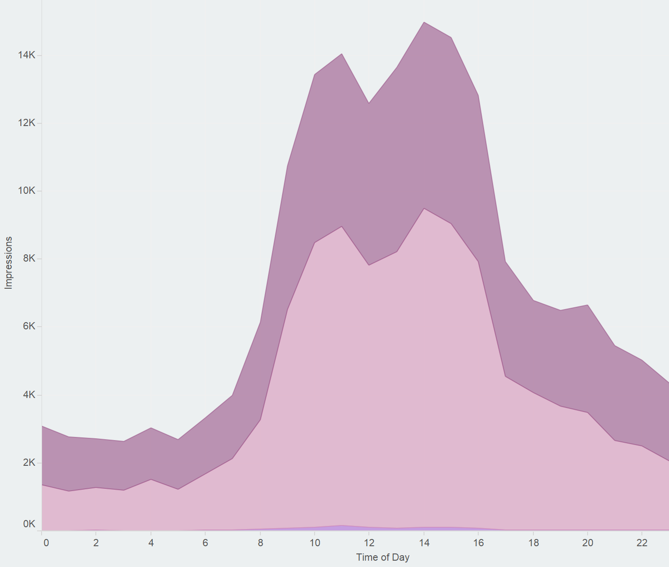

Measuring Genuine Use of Repository Content
at Northeastern University
Sarah Sweeney sj.sweeney@neu.edu
Northeastern University Libraries
repository.library.northeastern.edu
Usage Statistics in the Digital Repository Service
Repository usage statistics are utilized by content owners to measure the use and impact of repository materials and to measure the use of the repository as a whole. Given the value of these numbers, it is vital that we understand how repository statistics are gathered so we can sort genuine user interactions from automated bot traffic.
Early on in the DRS development process we decided not to leave our statistics in the hands of Google Analytics. While Google Analytics does a lot of valuable tracking, we cannot easily differentiate genuine user traffic from bot, crawler, or harvester traffic. To that end, we decided to limit what counts as use by disregarding counts generated by bots and other large consumers of our content.
Not All Traffic is Equal
A seemingly endless number of bots exist to crawl publicly available repository content for harvesting and indexing. These bots certainly help increase the discovery of repository content, but they can also greatly inflate usage statistics. Usage statistics are often gathered using third-party tools (often Google Analytics) which often do not report their collection methods, or simply do not differentiate bot indexing from human use. Although content owners tend to prefer higher numbers regardless of the consumer, we want to be able to defend the statistics we are gathering and declare them to be a genuine record of the use of our content by people, not bots.
Bots
April 2016 DRS Activity: Humans vs. Bots
Humans
Popular DRS Genres
Genre breakdown for top 25 DRS items.
Filtering
All impressions by all types of users are stored in a mySQL database: the impression tables. When the impressions table is processed, the user agent value is compared against the known bots list. A nightly processing job updates the table by marking impressions as “false” if the impression’s user agent matches a known bot. Impressions marked as generated by a bot are filtered out of the statistics that are displayed to users in the interface.
The Impressions Table
Every file view, download, and stream is counted as an impression and recorded in a mySQL database. Along with the type of impression, we also record the agent responsible for the impression, how they were referred to the file, the IP address, and the date of the impression. Frequency of impressions is limited to one per file per IP address per hour, which helps reduce inflated numbers from frequent clicking or page refreshing.
Thesis or Dissertation
Exam
ID | PID | session_id | action | ip_address | referrer | status | user_agent | public | created_at | updated_at | processed
184159 | neu:190034 | 5f79a9934… | view | 108.20.51… | direct | COMPLETE | Mozilla/5.0 (iPad; CPU OS… | TRUE | 5/21/15 9:41 | 1/22/16 1:58 | TRUE
184181 | neu:190034 | a745a871e… | view | 129.10.107… | direct | COMPLETE | Mozilla/5.0 (Windows NT 6.1… | TRUE | 5/21/15 12:32 | 1/22/16 1:58 | TRUE
184182 | neu:182058 | a745a8715… | download | 129.10.107… | direct | COMPLETE | Mozilla/5.0 (Windows NT 6.1… | TRUE | 5/21/15 12:33 | 1/22/16 1:58 | TRUE
184183 | neu:1302 | e5d85e81e… | view | 129.10.106… | https://repository… | COMPLETE | Mozilla/5.0 (Windows NT 6.1… | TRUE | 5/21/15 12:42 | 1/22/16 1:58 | TRUE
Faculty Research
Publication
Newspaper Issue
Report
Important Processing Values
Status: Files that are queued for download will be marked INCOMPLETE and are excluded until the download is complete.
Public: All impressions are set to TRUE. Impressions with agents on the bot list are marked as FALSE during overnight processing.
Processed: All impressions are initially set to FALSE. The value is set to TRUE once the impression has been processed for bots.
One Year of DRS Activity
Total views, downloads, and streams per month.
Bots
Views
Humans
Downloads
Ignored Agents
Agents listed in the impression table are compared against a list of keywords associated with common bots, like the Google and Yahoo indexing bots. Keywords include: *archive*, *bot*, *crawl*, *curl*, *java*, *lynx*, *nutch*, *scrape*, *scrapy*, *slurp*, *spider*
Streams
Leveraging the Data
By categorizing our traffic and sharing our statistics gathering process, we have been able to more accurately track how the DRS is being used, and has enabled us to more confidently defend our usage statistics as genuine use of repository content. In 2016 we plan to improve our data gathering practices by:
Adding a new data point for easier statistical processing
Operationalizing the process for adding new agents to the bot list
Displaying aggregated statistics on collection and community pages
Top Five Referrers
Top 5 agent referrers for page views.
Views
Downloads
Streams
Improved Workflows
We also would like to use the data to improve our workflows. For example, the chart on the right can tell us the best time of day to schedule system deploys.
Measuring impact accurately is a difficult task, as is being able to confidently defend how measurements are recorded. Although there is important statistical value in recording automated bot traffic, measuring and reporting genuine use can improve our ability to communicate the true value of repository content.
DRS Search and Browse
Google
Digital Repository Service
Learn More
For more information about the DRS visit dsg.neu.edu/resources/drs or github.com/NEU-Libraries/cerberus
Direct URL
Other
repository.library.northeastern.edu

Slide 2
Title
Northeastern University Library
Sarah Sweeney sj.sweeney@neu.edu
repository.library.northeastern.edu
Heading 1
Paragraph text
The community framework has not just neatly organized repository content according to the existing Northeastern college and department structure, it has made it easier for the system to leverage the relationships between objects to enhance the discoverability of scholarly content in the repository.
Heading 2
Valuable repository content can be discovered through multiple search and browse options.
Communities and collections are easily organized according to an existing authoritative framework.
The repository structure follows a model that is quickly understood by Northeastern users.
Learn More
For more information about the DRS visit
dsg.neu.edu/resources/drs or
github.com/NEU-Libraries/cerberus

